Slide 1
Using data analysis to establish knowledge structure
Zicheng-pan

Slide 2
One question:
How should we learn a new knowledge.
For example, now I want to learn JAVA or C++ or others.
How should I know which skills is necessary for this programing language, and what can I do after learning this programing language.
These things are related to build your knowledge structure.
next, I will show you the process about how I use the data to build my structure and in the end I will show you the benefit and the reason why we need to build the knowledge structure.

Slide 3
Definition:
What is data:
Data is a symbol or a symbol set that can be given a specific meaning.
The symbol can be a number, word, sound, picture, story, a predict, which can be meaningful.[follow my progress you can see the data is not only number]
What is information:
The Data + the related meaning, both compose the information.
A message which is the data carrier with a specific meaning. For example…
What is data analysis:
The process about getting the conclusion by the informations. Not only the data set, but the informations.
Notes:
The data not only the binary data can be anything
For example there is only a data set without any related information . So it is just a data set, it does not make any sense
If 13061993404 is a sequence but if I told you this is my phone number ,it is meaningfull
We get several conclusions by several data set , this process I called the data analysis

Slide 4
So everybody here is a programmer
Then I will demonstrate in a java language.
If I want to learn java, what should I do>
By reading a book, searching on the Internet or just ask someone to teach me.
But I should say “it is useful in one specific point, but not good for your knowledge system, we need a whole picture”

Slide 5
Firstly… in my mind is to search in the recruitment website to check the job description, which skill is necessary… useless skills are not required [my initial point]
互联网求职招聘找工作-上拉勾招聘-专业的互联网求职招聘网站 (lagou.com)
After this process, I get an overview about the industry, including the job background, the main technology skills,
Soft skills, etc…
Notes:
There are lots of jobs in a specific domain, so I just search java in the recruitment

Slide 6
Suggestions For web spider
Observations
Discover the common point and distinguishing point
url = “https://www.lagou.com/wn/jobs?px=new&xl=%E6%9C%AC%E7%A7%91&yx=25k-50k&kd=Java&pn=1&city=上海"
The result always in the same payload structure in HTML or JSON
Can be parsed by regular expression
Use cookie to avoid the robot validation.

Slide 7
After calculating the key words, also get the isolated knowledge point, not the knowledge structure.
So what should I do…
There is a viewpoint in my opinion that…
maybe you hurry to build the relation between these phrase.

Slide 8
The precondition:
If there is a knowledge needs to deliver to someone else, or one theory wants to go down in history and hand down a good reputation in next future hundred generations.
There must be a curriculum or a teaching material as a knowledge carrier.
Those contains all the information about the subject.
Notes:
Firstly I need to declare a point of view that,
一个知识体系，如果想要发扬光大，源远流长的话，那么就需要有人教，需要有教程 couse

Slide 9
The process about how to build my knowledge structure
By crossing checking, I search all the courses on the Internet, and summarize in the Excel, compare and summarize to get the difference and find the high frequency skill.
the reason why in this step, I manually to copy the content in the Excel not by a program… because I need to make sure that I am familiar with the content.
Finally I get the category about the JAVA.
Notes:
The aim is to finally abstract these component as my topology.

Slide 10
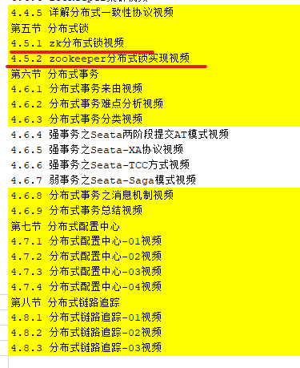
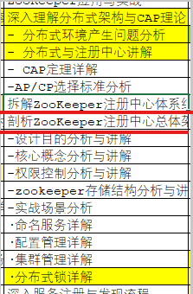
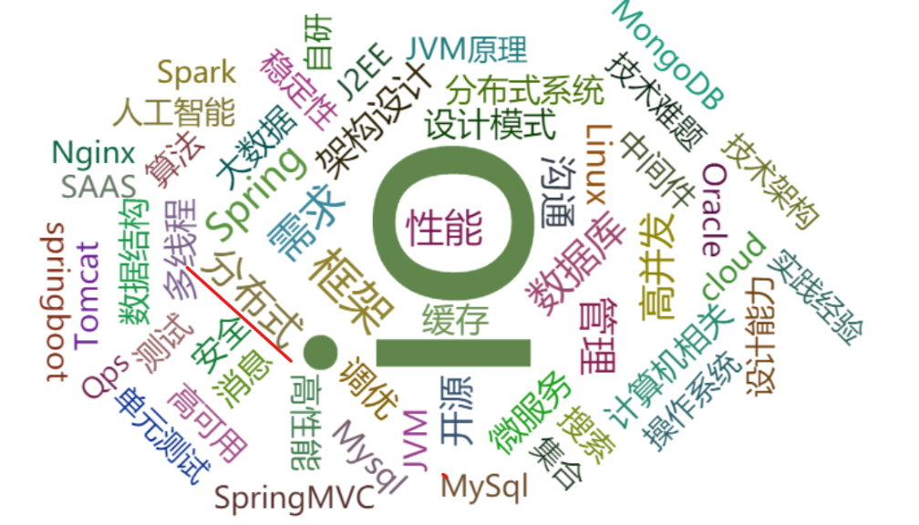
In the job list I see the distributed services are import so after I use the condition format in excel
网易云课堂
奈学教育

Slide 11
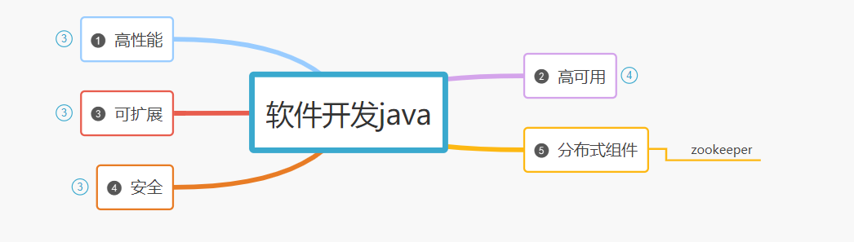
So I add the item in Distribute services component

Slide 12
Because there are lots of details, so this is just a progress to do,
先完成再完美 Finish First Then Perfect
Back to the beginning, why I need to do this?
May be I just read a book is a more easy way.
Just search how to learn java in zhihu is also a good idea.
Why I do it manually, or I just search it on the Internet

Slide 13
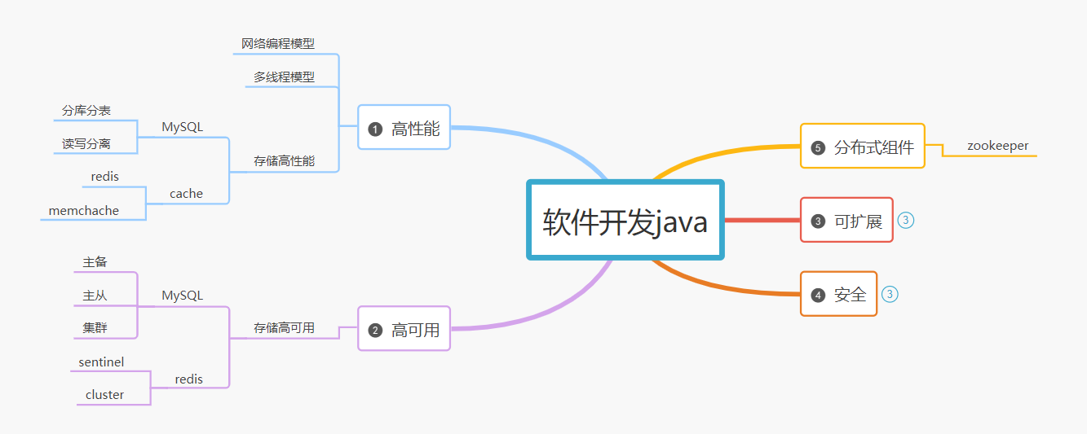
So this is a draft by my own the reason…
Notes:
Here you can see the Mysql DB is in the two
后面做架构设计的时候，也可以根据系统的难点和复杂度来分析，根据对比来进行选型
Architect

Slide 14
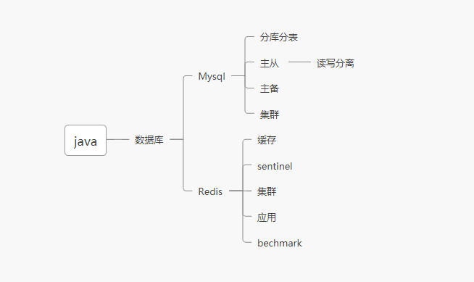
The first initial draft maybe like…
Notes:
There is another structure here you can see the difference, there is only single knowledge point list here but after know the reason why you learn this knowledge you can draw a high level structure

Slide 15
Finally
The knowledge system is not achieved overnight. Like learning knowledge, it needs constantly iterate . With the improvement of your knowledge, your knowledge topology is also becoming more and more perfect.
The benefit to build your topology is to avoid you to lost in the ocean of knowledge and to help you to know why you learn it.
Establishing your own knowledge system can completely know what problems your knowledge solves and what is the correlation between the current knowledge point and other contents
straddled the divide between thinking and doing[随着时间的推移经历了的，做了的，最终留下来的都会是财富，希望大家可以做到知行合一，加油共勉].
Notes:
知识体系不是一蹴而就的，和学习知识一样是需要不断迭代，随着你的知识的完善，你的知识的体系也是也越来完善的
时间是宝贵的，我们能做的就是在有限的时间做最有价值的事情
建立自己的知识体系可以完整的知道自己的这个知识是解决的什么问题，现在的这个知识点和其他的内容的相关性是什么
世界上平凡的工作太多了，知识点也太多了，很多的时候都是自己学习了都不会用，浪费了大量的时间，没有办法做到知行合一
大家加油

